Slide 1


Slide 2
Welcome to ICPNA ☺
Please pay attention…

Slide 3
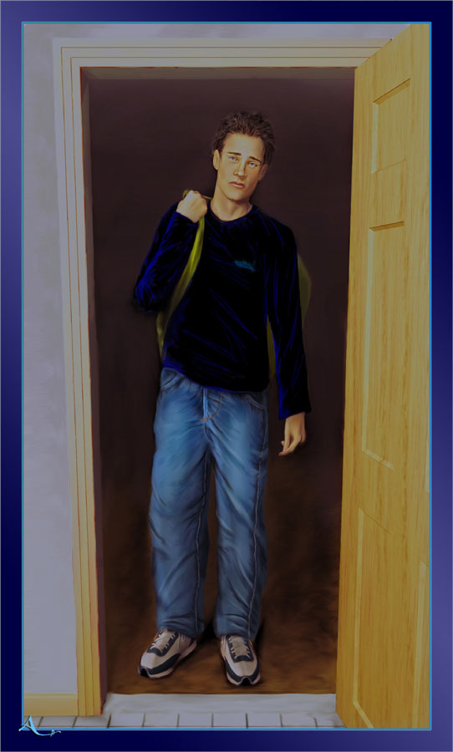
BASIC EVERYDAY EXPRESSIONS
May I come in?

Slide 4
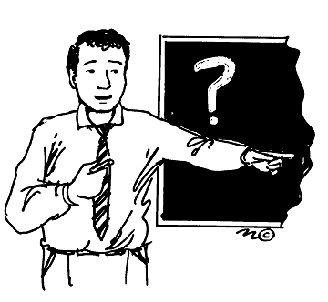
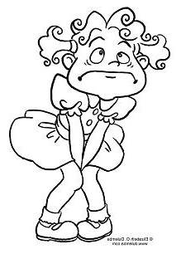
Important Phrases to remember
Blah blah blah …☺
No Spanish.. ☺
Teacher..ya no aguanto…. ☹
Profe…Baño…

Slide 5
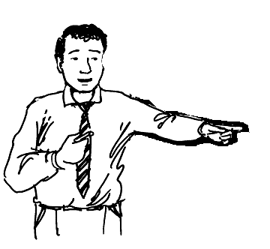
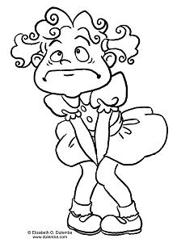
Correct way to ask…
May I go to the restroom, please ?
Excuse me, teacher.
Sure ☺
Yes ?

Slide 6
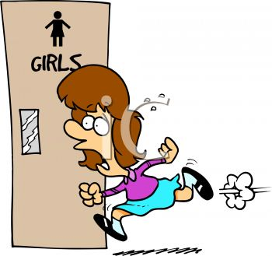
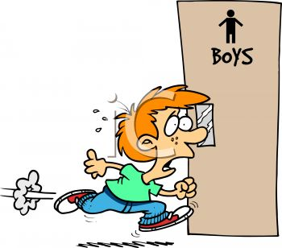
May I go to the restroom?
May I be excused?

Slide 7

READ

Slide 8
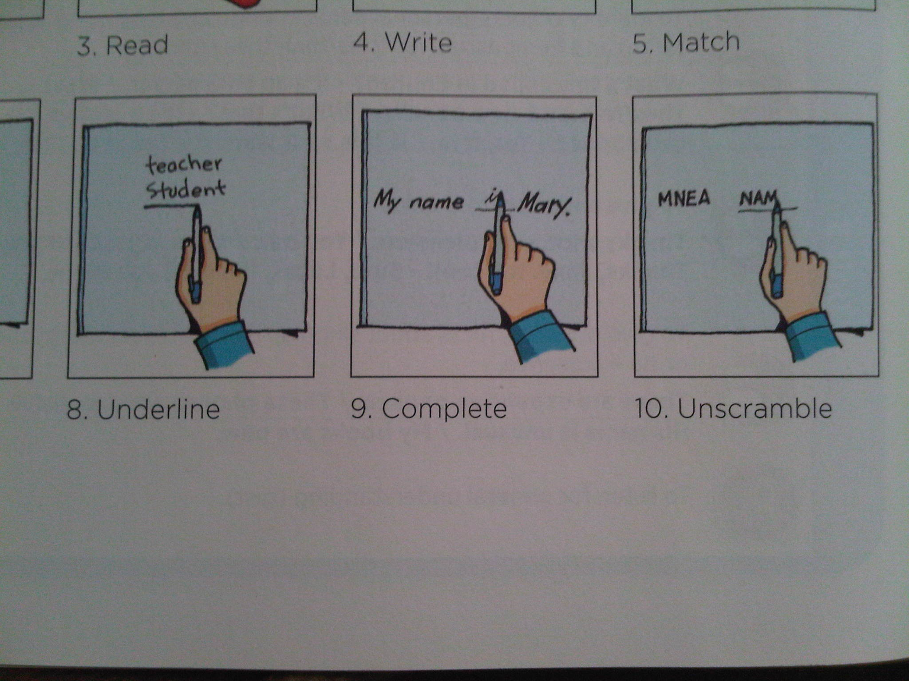
UNDERLINE

Slide 9

LISTEN

Slide 10
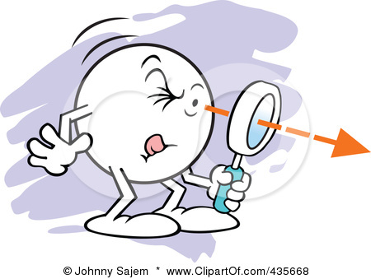
LOOK

Slide 11
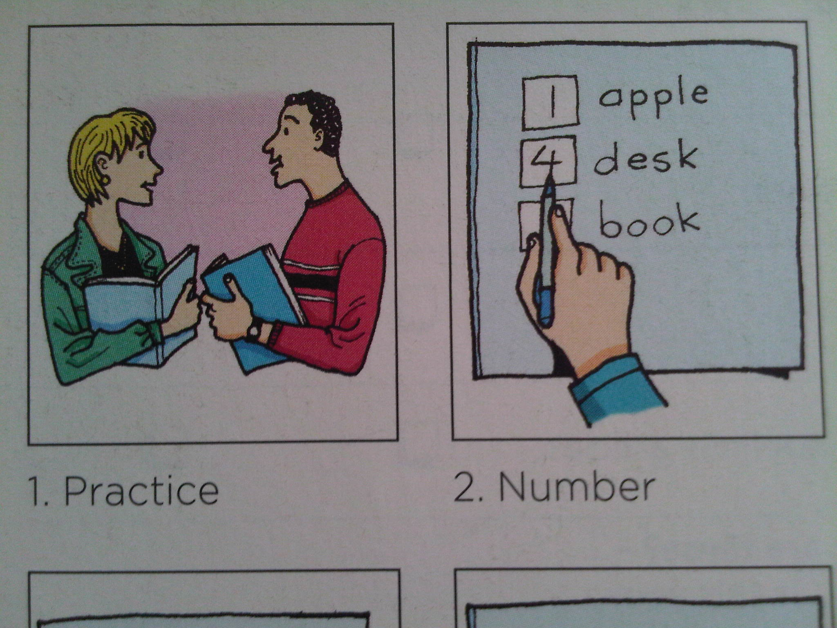
NUMBER

Slide 12

WRITE

Slide 13
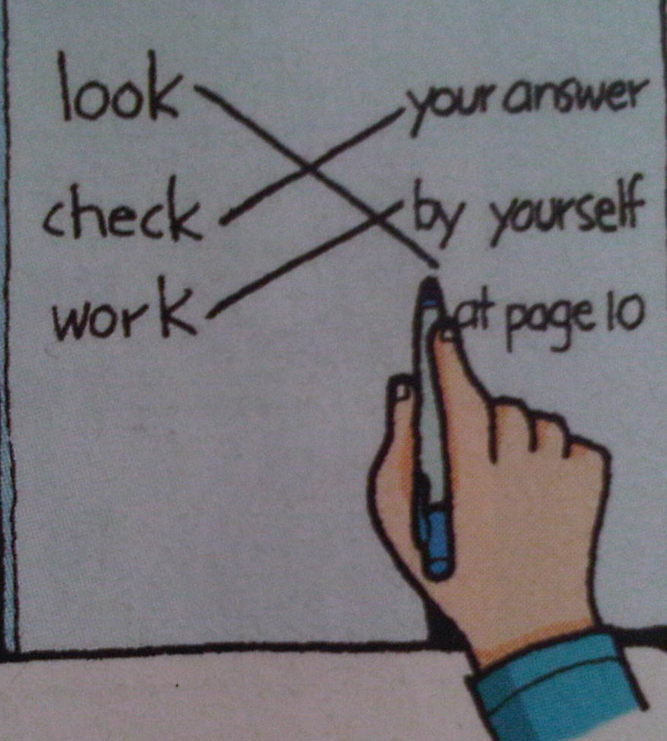
MATCH

Slide 14
Commands to remember…
Match
Age Juan
First name Garcia
E-mail Address 18
Last name 123@gmail.com
2
Age ___Juan
First name ___Garcia
E-mail Address ___ 18
Last name ___ 123@gmail.com
4
1
3
Unscramble
amNe
N
a
me

Slide 15
UNSCRAMBLE

Slide 16
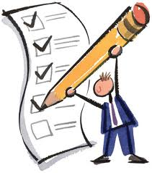
CHECK

Slide 17
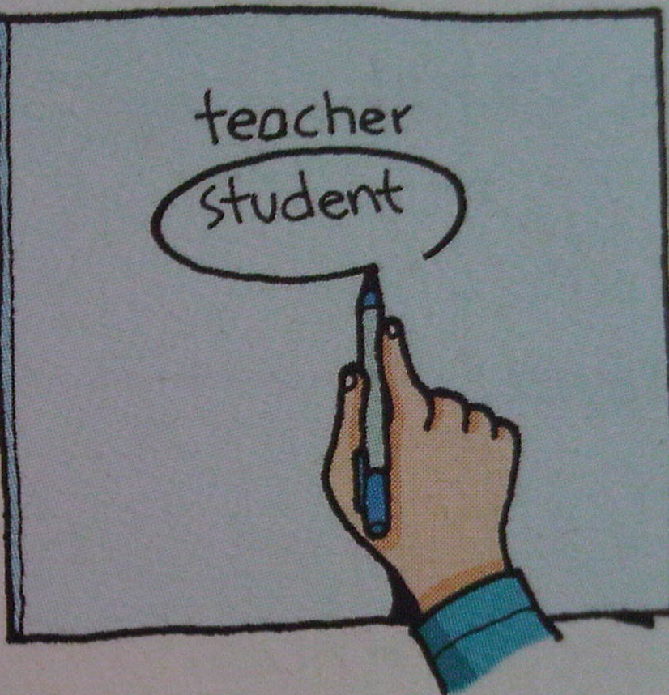
CIRCLE

Slide 18
PRACTICE

Slide 19
Commands to remember…
2
Number
____ Hi, my name is Juan
____ Nice to meet you.
____ Hello, What’s your name?
____ Nice to meet you
3
1
4
Cross
Hello
Underline
Hello
Circle
Hello

Slide 20

I don’t understand!
Can you repeat, please?

Slide 21
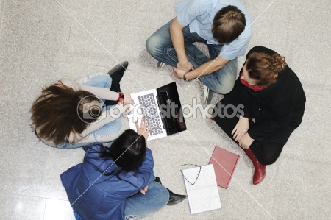
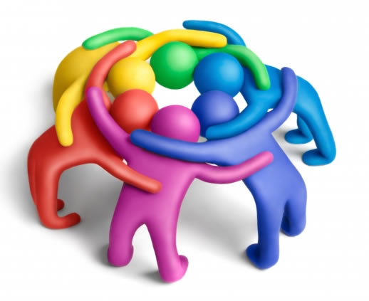
GROUP WORK

Slide 22

May I go to the bathroom / restroom?
Podria ir al baño, por favor?
What does _eraser_ mean?
Que significa_eraser?
How do you say _ _ in English?
Como se dice_resaltador_ en Ingles?
How do you spell highlighter?
Como se escribe highlighter?
H – i – g – h – l – i – g – h – t – e - r

Slide 23
How do you pronounce this ?
Como se pronuncia esto?
Can you repeat that, please?
Podria repetirlo, por favor?
Can you lend me an eraser?
Me puedes/podrias prestar un borrador?
What do we have to do?
Que tenemos que hacer? (Exercise)

Slide 24
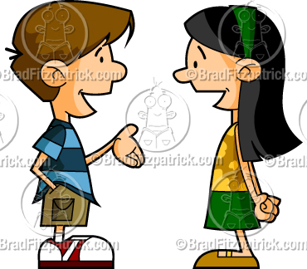


PAIR WORK
What do we have to do?
We have to ______________
Listen
Read
Write
Talk
What is the answer for Number ____?

Slide 25
BASIC EVERYDAY EXPRESSIONS
Greetings
Hello!
Good morning!
Good afternoon!
Good evening! 18:45 pm
Farewells
Bye!
Good bye!
See you tomorrow!

